Slide 1
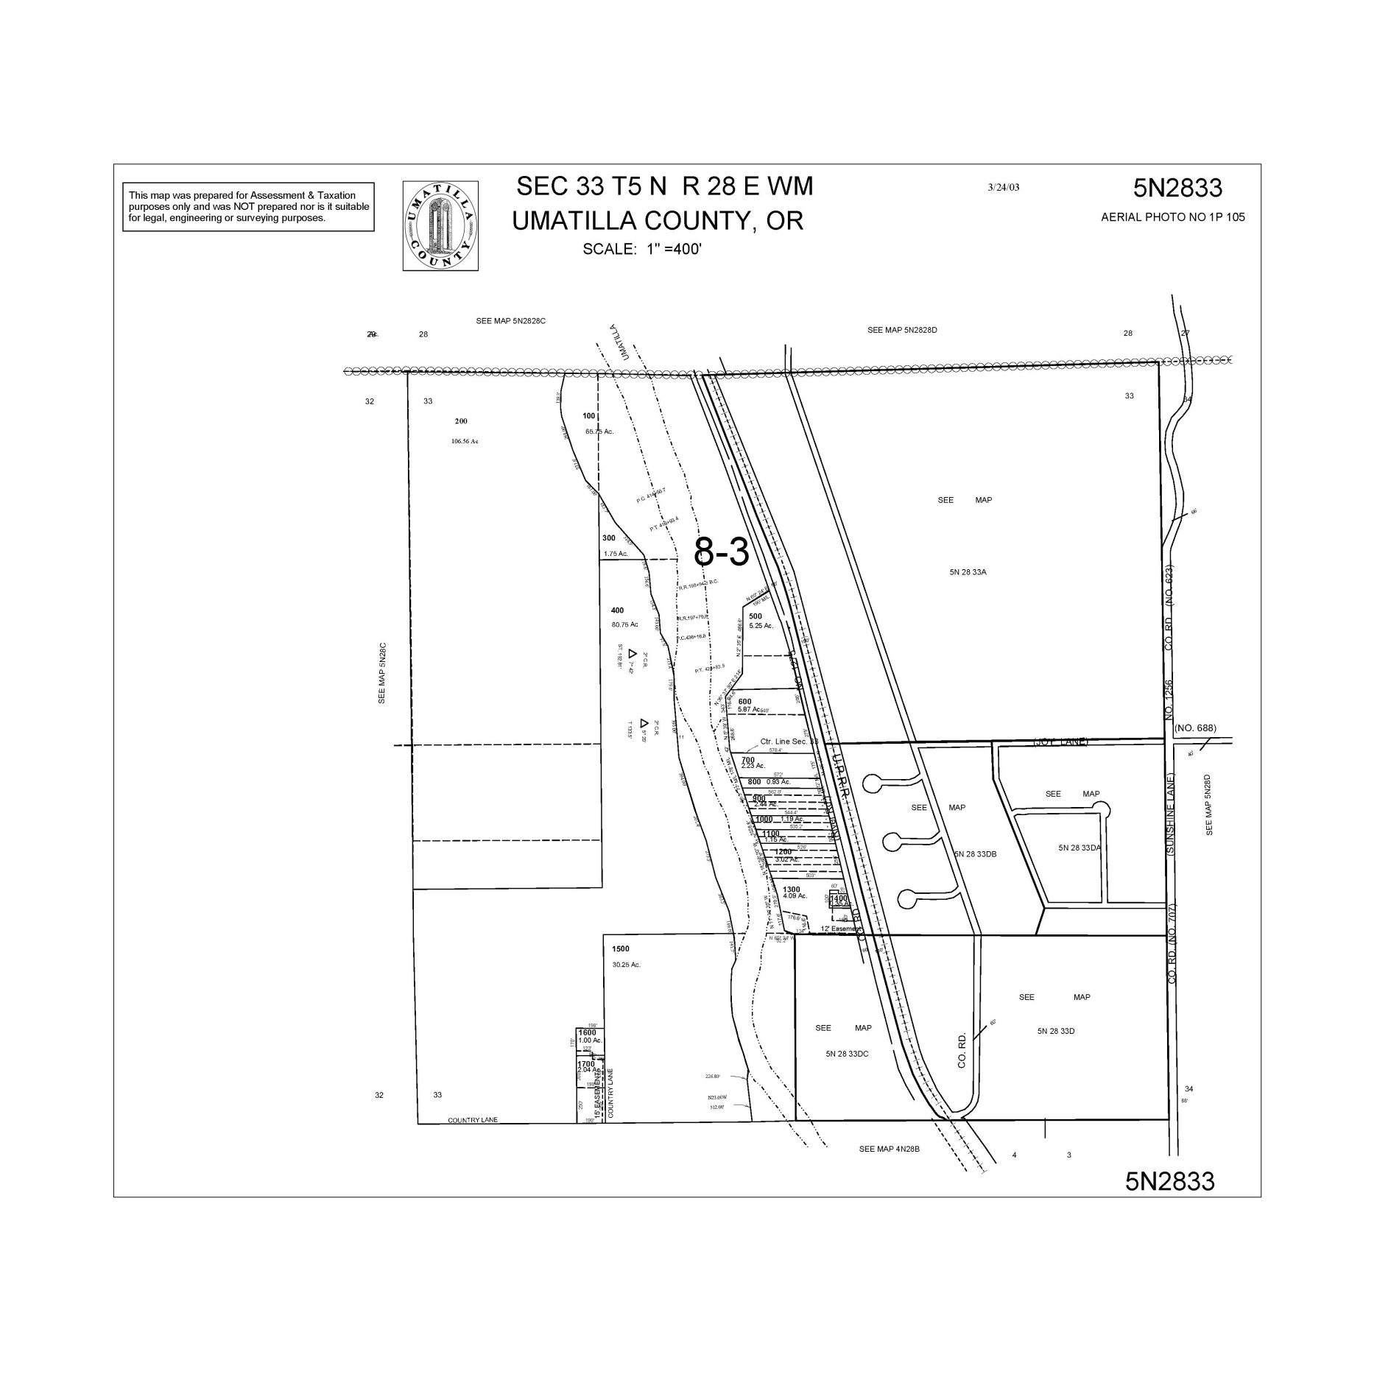
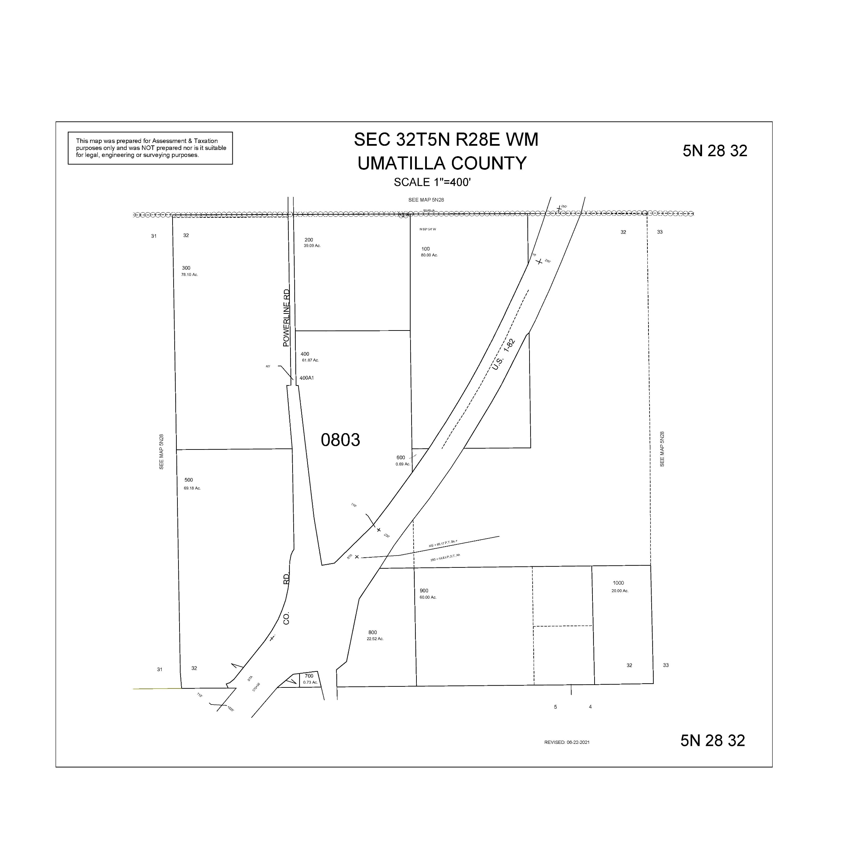
ALSO SEE SURVEYS 07-074-C, 09-040-A, 91-001-B, 94-171-G, I-016-C, S-156-C; CORNER RECORDS; G.L.O. SURVEYS
SURVEY NO. 313
OLD PRIVATE SURVEYS
SURVEY NO. 308, OLD PRIVATE SURVEYS
23-070-B
14-030-C
PPLAT 2015-10
SURVEYS NO. 308 & 326, OLD PRIVATE SURVEYS
SURVEY NO. 313
OLD PRIVATE SURVEYS
SURVEY NO. 313
OLD PRIVATE SURVEYS
15-025-B
08-136-B

